Slide 1
CS 262A: Advanced Topics in Computer Systems
Ali Ghodsi and Ion Stoica
August 26, 2020

Slide 2
Course Information
Course website:
https://ucbrise.github.io/cs262a-fall2020/
It is on Github so you can contribute content!
Schedule and reading list are subject to change

Slide 3
Who are we?
Ali Ghodsi
Adjunct Professor, UC Berkeley (Systems, Databases)
CEO, co-founder, Databricks
Assistant Professor, KTH (2008-2009)
OSS involvement: Apache Spark, Apache Mesos, Alluxio, Delta, MLFlow
Ion Stoica
Professor, UC Berkeley (Systems, Networking)
Co-founder: Databricks, Anyscale, Conviva
OSS involvement: Apache Spark, Ray, Apache Mesos, Alluxio, Clipper
We have been working together since 2009!

Slide 4
Who are we?
Michael Whittaker
TA
PhD Student (Databases)
Research focused on replication, consistency, and consensus algorithms for distributed systems

Slide 5
What is System Research about?
Manage resources:
Memory, CPU, storage
Data (database systems)
Provide abstractions to applications:
File systems
Processes, threads
VM, containers
Naming system
…

Slide 6
This Class
Learn about systems research by
Reading several seminal papers
Doing it: work on an exciting project
Hopefully start next generation of impactful systems

Slide 7
Appreciate what is Good Research
Problem selection
Solution & research methodology
Presentation

Slide 8
What do you need to do?
Research oriented class project
Groups of 2-3
Paper reading
Paper presentations

Slide 9
Research Project
Investigate new ideas and solutions in a class research project
Define the problem
Execute the research
Write up and present your research
Ideally, best projects will become conference papers (e.g., OSDI/SOSP, NSDI, EuroSys)

Slide 10
Research Project: Steps
We’ll distribute a list of projects
You can either choose one or come up with your own
Pick your partner(s) and submit a one-page proposal describing:
The problem you are solving
Your plan of attack with milestones and dates
Any special resources you may need
Poster session
Submit project report

Slide 11
Paper Reading
All students are required to read all papers
All students are required to submit “reviews” for each paper:
Answer four short questions on google form (see next slide)
We will send out how to signup for papers later today

Slide 12
Paper Reading: Key Questions
What is the problem?
What is the solution’s main idea?
Why did it succeed or failed?
Does the paper (or do you) identify any fundamental/hard trade-offs?
Submissions: Will send out a google form for every paper that you need to fill in (will close it 10min before the class)

Slide 13
Distributed Shared Memory
Countless papers in 1990s:
Very compelling abstraction
Many hard challenges, so many researchers worked on it
Today
Few systems using distributed shared memory, if any
Note: Comeback in the context of disaggregated memory?
Message passing (e.g., MPI) or bulk synchronous processing (e.g., Spark) prevalent

Slide 14
Why did it fail?

Slide 15
Virtual Machine
Many papers in 1990s:
Very compelling abstraction
Many hard challenges, so many researchers worked on it
Today
VMs everywhere
Containers (e.g., docker) take this concept to the next level

Slide 16
Why did it succeed?

Slide 17
What are Hard/Fundamental Tradeoffs?
Brewer’s CAP conjecture: “Consistency, Availability, Partition-tolerance”, you can have only 2/3 in a distributed system
Tradeoff between latency and throughput for arbitrary updates in distributed systems
Batch request to increase throughput, but hurts latency

Slide 18
Paper Presentation
Each student must present at least one paper
You must submit slides for review one week before presentation for feedback
Please use Google slides

Slide 19
Lecture Format (starting with 9/7)
Faculty will provide context of the topic (10-15min)
Next, papers presented by students
Two presentations of 15min each, followed by 20min discussion

Slide 20
Grading Policy
20% Class Participation
Answer questions, join discussion, and present papers
20% Paper reviews
60% Project

Slide 21
Grading
Project: 60%
Paper blogs: 20%
Class participation: 20%

Slide 22
Exciting times in systems research
Moore’s law ending → many challenges
Huge servers
Specialized hardware
Distributed computing
Serverless computing
…

Slide 23
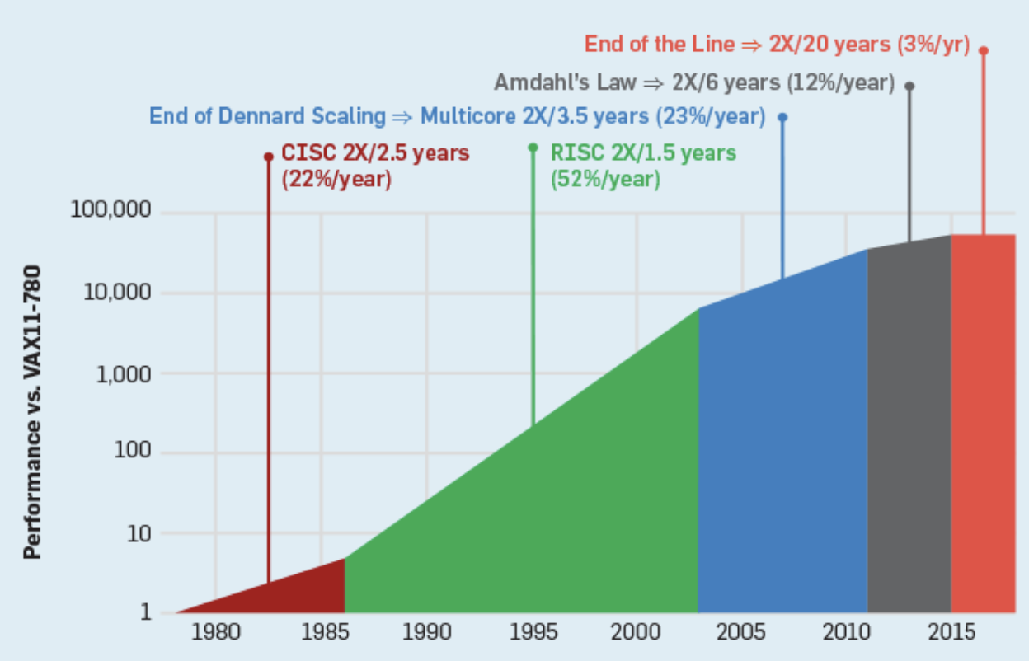
Moore’s Law ending

Slide 24
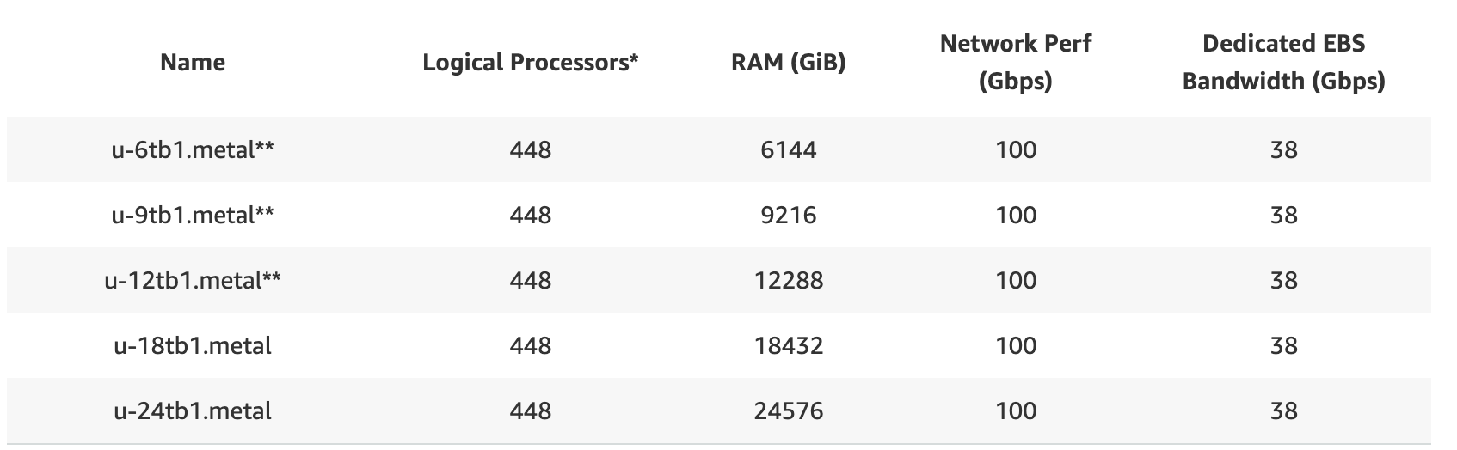
Huge Servers
AWS high-memory instances
24TB !

Slide 25
Specialized hardware
Trade generality for performance

Slide 26
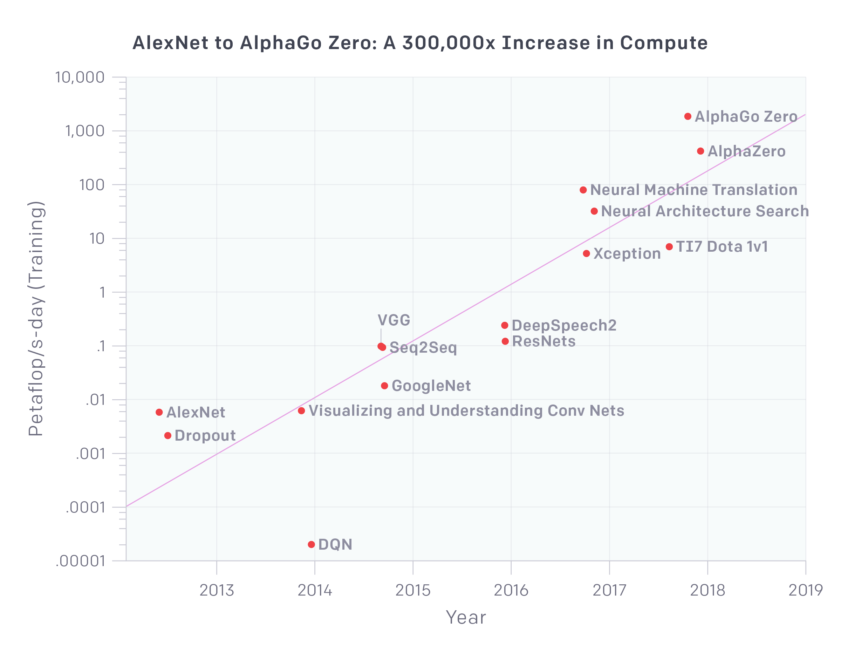
Deep Learning Demands
35x every 18 months
(https://openai.com/blog/ai-and-compute//)

Slide 27
Not only esoteric apps
ResNeXt 101
image processing
ResNet 50
translation
(https://openai.com/blog/ai-and-compute//)

Slide 28
Specialized hardware not enough
35x every 18 months
TPU
GPU
Moore’s Law (2x every 18 months)
CPU
No way out but distributed!
(https://openai.com/blog/ai-and-compute//)

Slide 29
Serverless
Make distributed applications easy
Serverless:
Abstract away servers/clusters
Pay-per-use (e.g., 100ms increments)
Natural progression: cloud agnostic!

Slide 30
What is a good problem to work on?
Impact: someone cares about solving the problem
The more people care, the better
Priority: you are among the first to work on the problem
Increases the chances of being first to solve this problem
Caveat: This is just “nice to have”. If you believe it’s an important problem and you are passionate bout it, go for it!
Edge: You have an expertise (edge) to solve the problem
Incremental: can be partitioned into sub-problems
Help you make rapid progress, iterate, better understand the problem

Slide 31
Impact (1/2)
Do things that have not been done before
“It always seems impossible until is done” – Nelson Mandela
Examples: zero-knowledge proof, beating chess/go world champion, …
Do things much better than before (e.g., 10x)
Examples: GPUs, Distributed Hash Tables (routing efficiency), in-memory databases, CNNs, …

Slide 32
Impact (2/2)
Theory
Improve space/time complexity of wide used algo (e.g., SGD)
Extend existing techniques to new domains/environments, e.g., fair scheduler from network to CPU, distributed graph algorithms
Prove new desirable properties for popular techniques (increase practitioners confidence in using them), e.g., show an allocation algo is strategy proof, show an algo is guaranteed to converge
Systems
Support new workloads impractical before, e.g., big data processing
Significantly improve efficiency/speed/cost, e.g., GPUs, dist algos
“Democratize” technology, e.g., cloud computing, serverless, TensorFlow

Slide 33
Priority (1/2)
You experience problem first-hand
One of the main reasons we are building systems/artifacts
Build system solving a “need”
Have people use it
Understand things people want to do with your system, you haven’t thought about
Now you have a problem, you’ve “seen” first!
Take a bet on a new area and dive in
Because it’s new area, few people are working on it
This is one thing Berkeley has been excelling at, e.g.,
Complexity theory, approximate algorithms, databases, networking, sensor networks, OSes (UNIX), NOW, Big Data, ML, …

Slide 34
Priority (2/2)
Talk with people from other areas to find new problems, e.g.,
Spark motivated by Matei’s trying to solve a ML postdoc’s (Lester Mackey) problem
Berkeley’s labs are set up to encourage you do exactly this!
“I notice that if you have the door to your office closed, you get more work done today and tomorrow, and you are more productive than most. But 10 years later somehow you don't know quite know what problems are worth working on; all the hard work you do is sort of tangential in importance. … I can say there is a pretty good correlation between those who work with the doors open and those who ultimately do important things.”
– Richard Hamming, Turing Award Winner
(“You and Your Research” : http://www.cs.virginia.edu/~robins/YouAndYourResearch.html)

Slide 35
Edge
If you do not have expertise to solve the problem, talk with people who do!
Again, labs like RISELab are set up to encourage you do exactly this!

Slide 36
Incrementality
Reach the first meaningful milestone fast
Critical to get the project off the ground, maintain the excitement of the students and, if a system, start growing community
Examples: Mesos, Spark provided an useful system within 1 year
Decompose project in a series of milestones providing increasing value
Examples: Spark core → Shark (SQL) → Streaming → Mllib
Developing a chess algorithm to first beat an amateur, then a master, then a grand master, and finally the world champion
Holly grail example: Bell Labs achieving its vision of “enabling any two people in the world communicate”
Enable two people to talk by phone between Boston and NY
Enable two people to talk by phone across US between NY and SF
Enable two people to talk by phone across Atlantic between NY and London…. (see “The Idea Factory” book)

Slide 37
Questions to ask when picking a problem
What will happen if I solve this problem? Will anyone care? Will anything change in the way people do things?
If you hope for a quantitative gain, simplify the problem and see improvement; if improvement not what you hopped for, reconsider
Who else is working on the problem? (Again, big caveat here; if you believe the problem is important an you can solve it go for it!)
Why me? Do I have any edge on solving this problem? Am I expert in some techniques I think it will help me solve it? Did I solve similar problems?
Is there a meaningful milestone I can get to fast?

Slide 38
Some problems I worked on
Problem | Impact (problem formulation) | Priority | Edge | Incremental | Comments
Chord | Need for decentralized (no liability), efficient P2P system | Among several groups working on it | Experts in distributed systems and algorithms | Followed by many refinements | At some point, most cited paper
13,600+ citations

Slide 39
Some problems I worked on
Problem | Impact (problem formulation) | Priority | Edge | Incremental | Comments
Chord | Need for decentralized (no liability), efficient P2P system | Among several groups working on it | Experts in distributed systems and algorithms | Followed by many refinements | At some point, most cited paper
Spark | Need for fast, general-purpose big data analytics | Among first to see ML use cases (AMPLab) and interactive queries (industry; Conviva, FB) | Already experts in big data (in academia); started working on this 3 years earlier | Core Spark (3,000 LoC); Shark, Streaming, ML libs | High impact in industry
13,600+ citations
3,940+ citations

Slide 40
Some problems I/we worked on
Problem | Impact (problem formulation) | Priority | Edge | Incremental | Comments
Chord | Need for decentralized (no liability), efficient P2P system | Among several groups working on it | Experts in distributed systems and algorithms | Followed by many refinements | At some point, most cited paper
Spark | Need for fast, general-purpose big data analytics | Among first to see ML use cases (AMPLab) and interactive queries (industry; Conviva, FB) | Already experts in big data (in academia); started working on this 3 years earlier | Core Spark (3,000 LoC); Shark, Streaming, ML libs | High impact in industry
Dominant Resource Fairness (DRF) | Need for better utilization for multi resource types workloads | Among first to see the problem (Mesos) | Experts in scheduling algorithms | Followed by other papers in different areas | Intellectual impact (microeconomy); implemented in a few systems
14K+ citations
5K+ citations
1K+ citations

